Slide 1
CoMSEF Breakfast Meeting
Tuesday, 10-Nov, 7:15am, La Bella Piastra in the Marriott City Center
Attendance
  Michael Shirts, Dave Kofke, Coray Colina, Erik Santiso, Lev Gelb, Joe Golab, David Sholl, Jeff Errington, Vanessa Ortiz, Rachel Getman, Karl Johnson, and Jonathan Moore
Agenda
  Finances: – see PPTX from CoMSEF business meeting
  Membership: In theory, CoMSEF has over 1000 members, mostly undergrads that appear were added by AIChE. Besides the newsletter, what else can we promote? Of our approximately 230 paid members, about 10% are female. What can we do to attract more females into CoMSEF? Add a new initiative, e.g. new award? new session? new topic based on the development of codes and software?
    Offer a $50 award for a student’s contribution to the CoMSEF Newsletter. It should be on a scientific topic (review of a paper, research highlight, etc) and reviewed by a CoMSEF committee before inclusion but would offer the student a citation.
    Double check how many members are graduate students and/ or post-docs. Seems the number reported by AIChE has dropped dramatically.
    All CoMSEF session chairs should announce CoMSEF sponsorship and encourage membership in the Forum
    Increase CoMSEF presence or sponsorship of sessions that attract women participation, e.g. bio related
    Host a CoMSEF dinner at a forthcoming Fall meeting to celebrate an anniversary? CoMSEF was approved by AIChE in 2000.
  CoMSEF sessions running well. New session ideas are welcome but we are limited to ten for San Fran. Send suggestions to Jeff.
  Awards: Faculty award nominations are lower than in past years.
    Send Email to all poster presenters to remind of Graduate Student Award. This should be sent to all members reminding them a poster is evaluated even if they really want to give a talk, i.e. submit both talk and poster
    Send Email to the department chair and/ or department’s Award Committee chair
    Follow up with past award winners; sort of a “Where are they now?” Newsletter section

Slide 2
Business Meeting Topics
Wednesday, 11-Nov, 6:15pm, SLC-CC 255B
Attendance: ~ 75 People
CoMSEF Awards
  FOMMS 2015 Conference Award – Kayla Sprenger, U of Washington (Advisor: Jim Pfaendtner)
  Impact Award & Plaque – Cameron Abrams, Drexel U
  Young Investigator Award & Plaque – Joshua Anderson, U of Michigan
  Graduate Student Poster Awards – Abhiram Muralidhar (Dorfman) & Christopher Paolucci (Schneider)
  New $50 award for students who write a scientific, reviewed highlight for the CoMSEF Newsletter to start in 2016 – details coming to the web site
New Liaison Directors – Vanessa Ortiz and Rachel Getman
CoMSEF Sessions
  2015 going well
  Session Ideas and Chair Volunteers for 2016 please contact Jeff before 14-Dec-2015
Financial Report: Unlike past years, expenses (awards) will exceed revenue (dues) because of Conference Award; however, expect a 2016 carryover of about $1700
FOMMS 2018
  July 22-26 or July 29-August 2; location TBD
  Clare Adjiman, Jeff Errington, and Ilja Siepmann are chairs

Slide 3
Business Meeting Topics
Announcements
  AIChE Institute Lecture named for John M Prausnitz
    Tribute Issue, AIChE J., September 2015
    Renaming the lecture does not change selection criteria
    Online donation to endow the lecture
    Request to Area 1a to nominate the “right” person for the 1st lecture (2016)

Slide 4
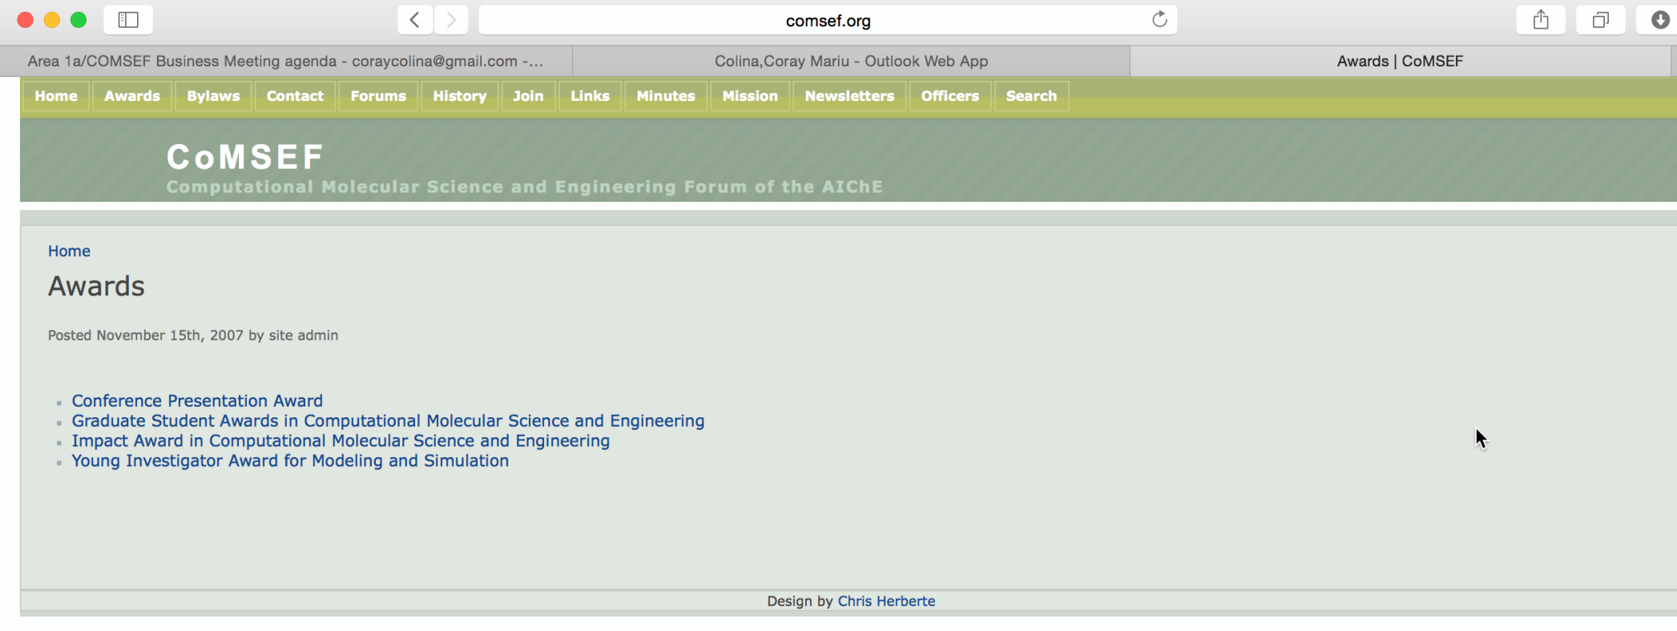
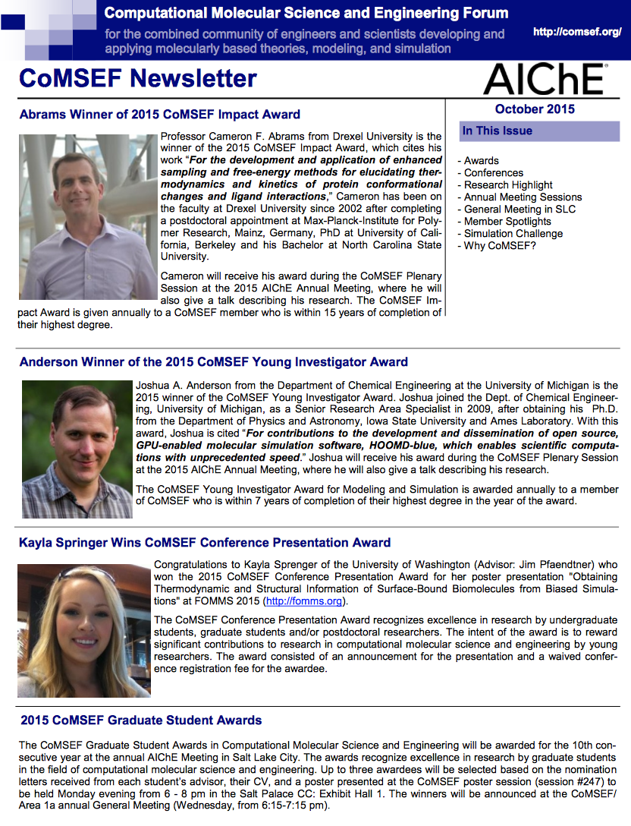
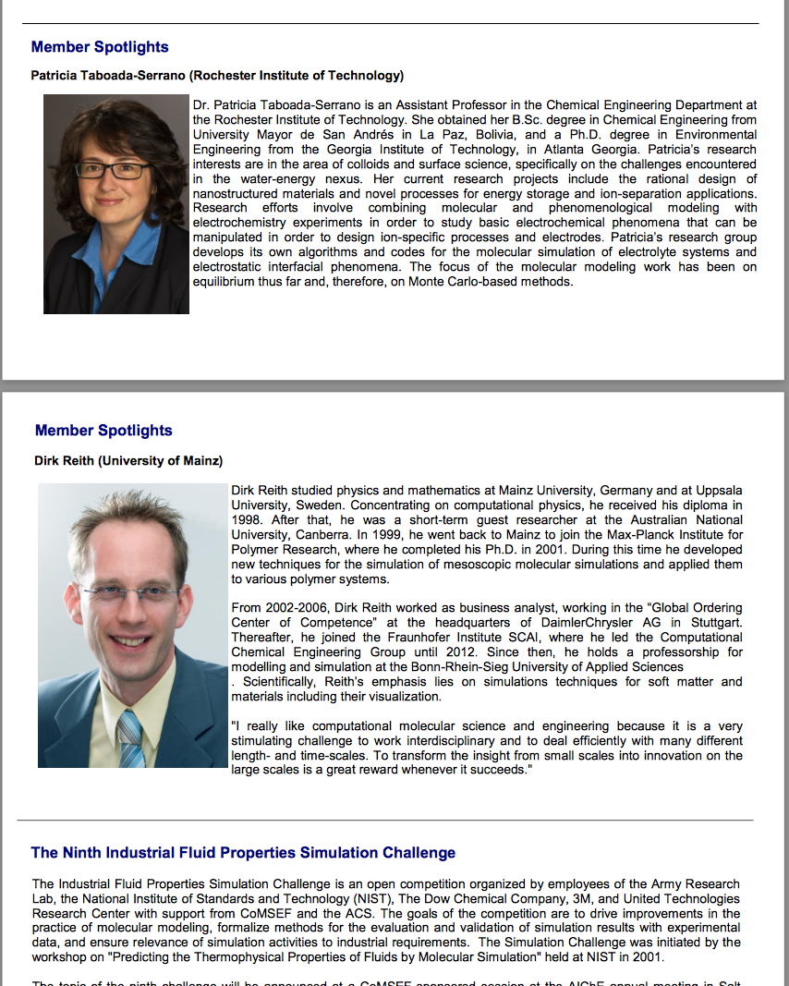
COMSEF Awards and Newsletter

Slide 5
2015 CoMSEF ELECTIONS
Liaison Directors (2015-2017)
  Vanessa Ortiz
  Rachel Getman
Liaison Directors (2014-2016)
  Erik Santiso
  Michael Shirts
Liaison Directors (2013-2015)
  Karl Johnson
  Lev Gelb

Slide 6
CoMSEF Financials: 2014
2013 Carryover $2359
Total Revenue $2366 (dues $10/year)
Total Expenses $1691
  Impact Award & Plaque
  Young Investigator Award & Plaque
  Two Graduate Student Poster Awards
End of Year Balance $3034

Slide 7
CoMSEF Financials: FORECAST
Balance (as of Sep) … ($255)
  2014 Carryover $3034
  Current Revenue $1745
  Current Expenses $2000
    FOMMS 2015 Conference Award
      Kayla Sprenger, U of Washington (Advisor: Jim Pfaendtner)
2015 Forecast
  Total Revenue $2300 (est)
  Total Expenses $3700 (est)
    Impact Award & Plaque – Cameron Abrams, Drexel U
    Young Investigator Award & Plaque – Joshua Anderson, U of Michigan
    Two Graduate Student Poster Awards
  Carryover $1634 (est)

Slide 8
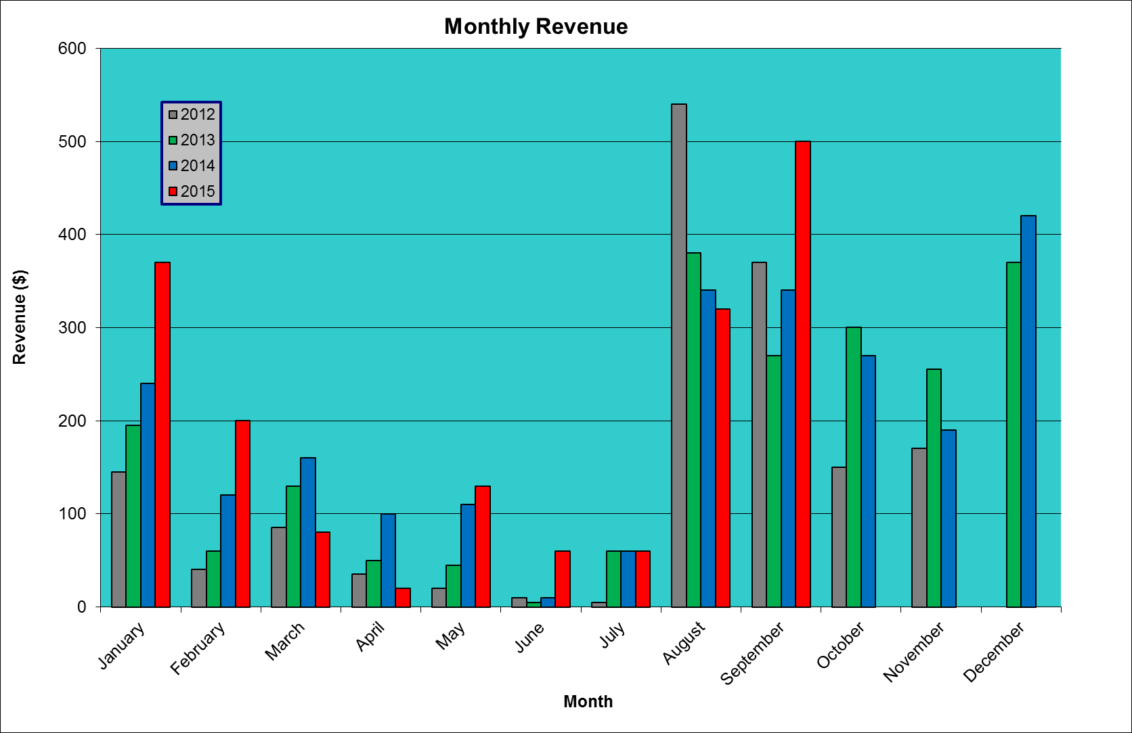
REMEMBER to renew membership and/or recruit members

Slide 9
Join COMSEF!
Membership in CoMSEF is only $10 (free for Graduate students)! As a CoMSEF member you can be nominated (if eligible) for one of the CoMSEF awards.
Membership in AIChE is not a requirement to join CoMSEF; however, if you're not a member, you might consider joining if you are interested in being an officer of CoMSEF.
Additionally, as a CoMSEF member you will receive a copy of our semi-annual newsletter, which highlights CoMSEF activities, opportunities, and recent papers in the literature, and upcoming conferences of interest to the CoMSEF community.
If you are already a member of AIChE, to join CoMSEF simply tick the CoMSEF box on your AIChE dues notice (online or paper). Alternatively, you can join at any time online at the following link: join. If you are not a member of AIChE, you can call AIChE customer service and they will take your request to join the division and bill you ($10 for CoMSEF, free for students). You can reach AIChE customer service at: 800-242-4363.

Slide 10
2015 CoMSEF Sessions

Slide 11
2016 CoMSEF Sessions
If you are interested in chairing a session, please contact me

Slide 12
2015 Graduate Student Awards
Abhiram Muralidhar
Advisor: Kevin Dorfman
Institution: University of Minnesota
Christopher Paolucci
Advisor: William Schneider
Institution: University of Notre Dame
Karla Sprenger
Advisor: Jim Pfaendtner
Institution: University of Washington
2015 CoMSEF Conference Presentation Award

Slide 13

Sustainable Separation Processes:
Accelerating Industrial Application of Less Energy-Intensive Alternative Separations
C&EN Web Date: May 12, 2015
Green Chemistry Institute Receives $500,000 Federal Grant
Sustainability: Advanced manufacturing project aims to boost development of environmentally-friendly separation processes.
The goal of the two-year NIST AMTech planning project is to create an innovation roadmap for advancing the rational design and predictable, widespread industrial application of less energy-intensive separation processes as alternatives to distillation. The collaboratively-developed roadmap will identify and prioritize research, development, and demonstration needs starting at the molecular level.
The roadmap will be developed via 3 workshops in 2016; the first is planned for Feb. 17-18 at ACS in D.C.
We need: | Please contact:
Info on the types of separations currently via distillation to align roadmapping with industrial needs. | robert.j.giraud@chemours.com
Collaborators to describe path from defining mixture composition to obtaining molecular properties. | robert.j.giraud@chemours.com
Practitioners and researchers to sign up to participate in roadmapping workshops. | gciroundtable@acs.org
Learn more at http://altsep.org
AIChE 2015 Annual Meeting

